Slide 1

Welcome to the 'sweet taste' of our Failosophy

Slide 2

What will we share with you today?
Who are we and what drives us?
How it all began – we had a dream...
Facts and figures 2018 - 2025
Our Challenges & Failures
Our case: The Bosshardtjes
What We Learned
Why Failure Matters
Fire away – ready for questions

Slide 3
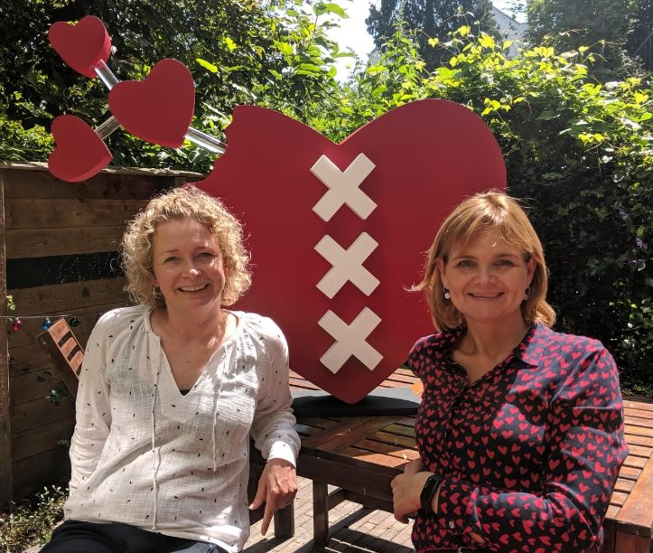
Who are we?

Slide 4
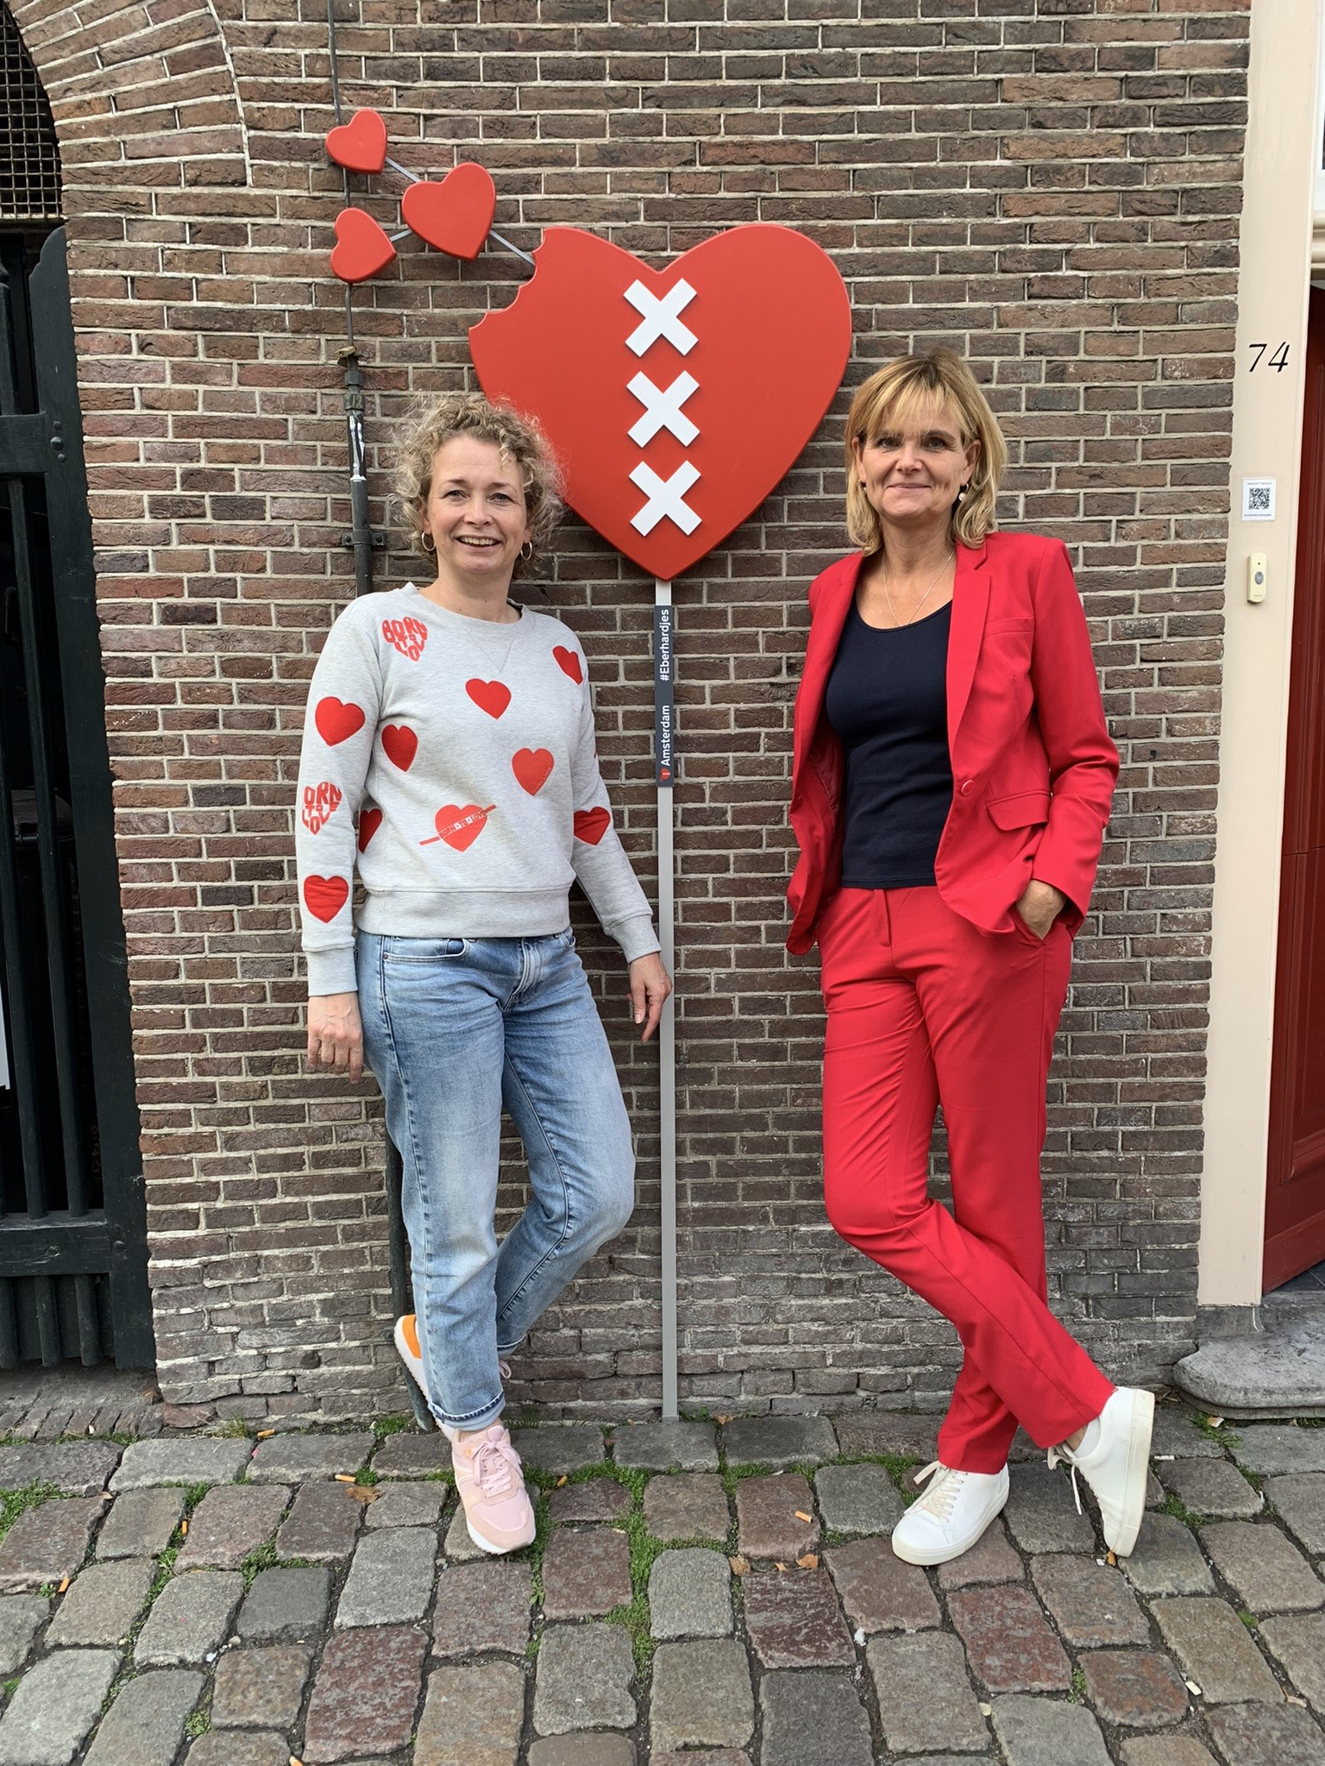
What drives us?
Ineke Kuiper
Résalieke Vlieger
‘There are more of us – people who’ll focus on the good’

Slide 5
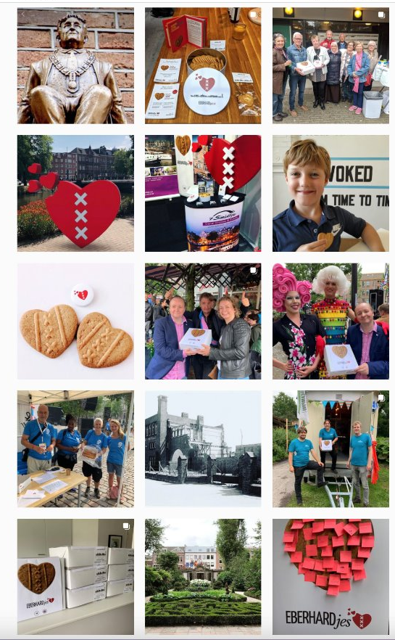
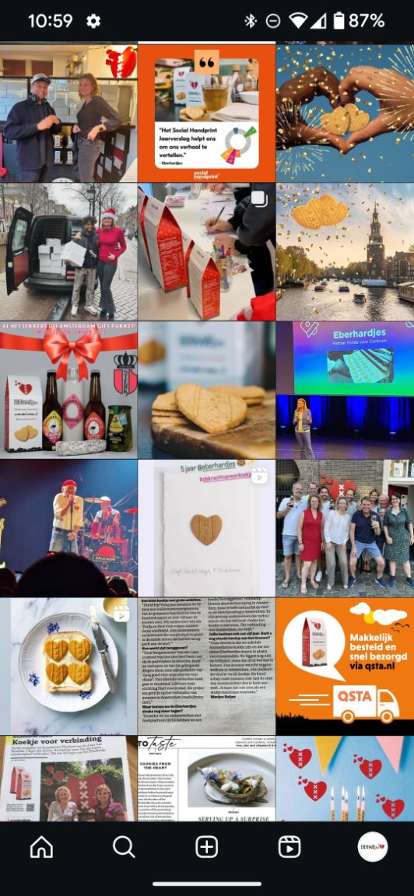
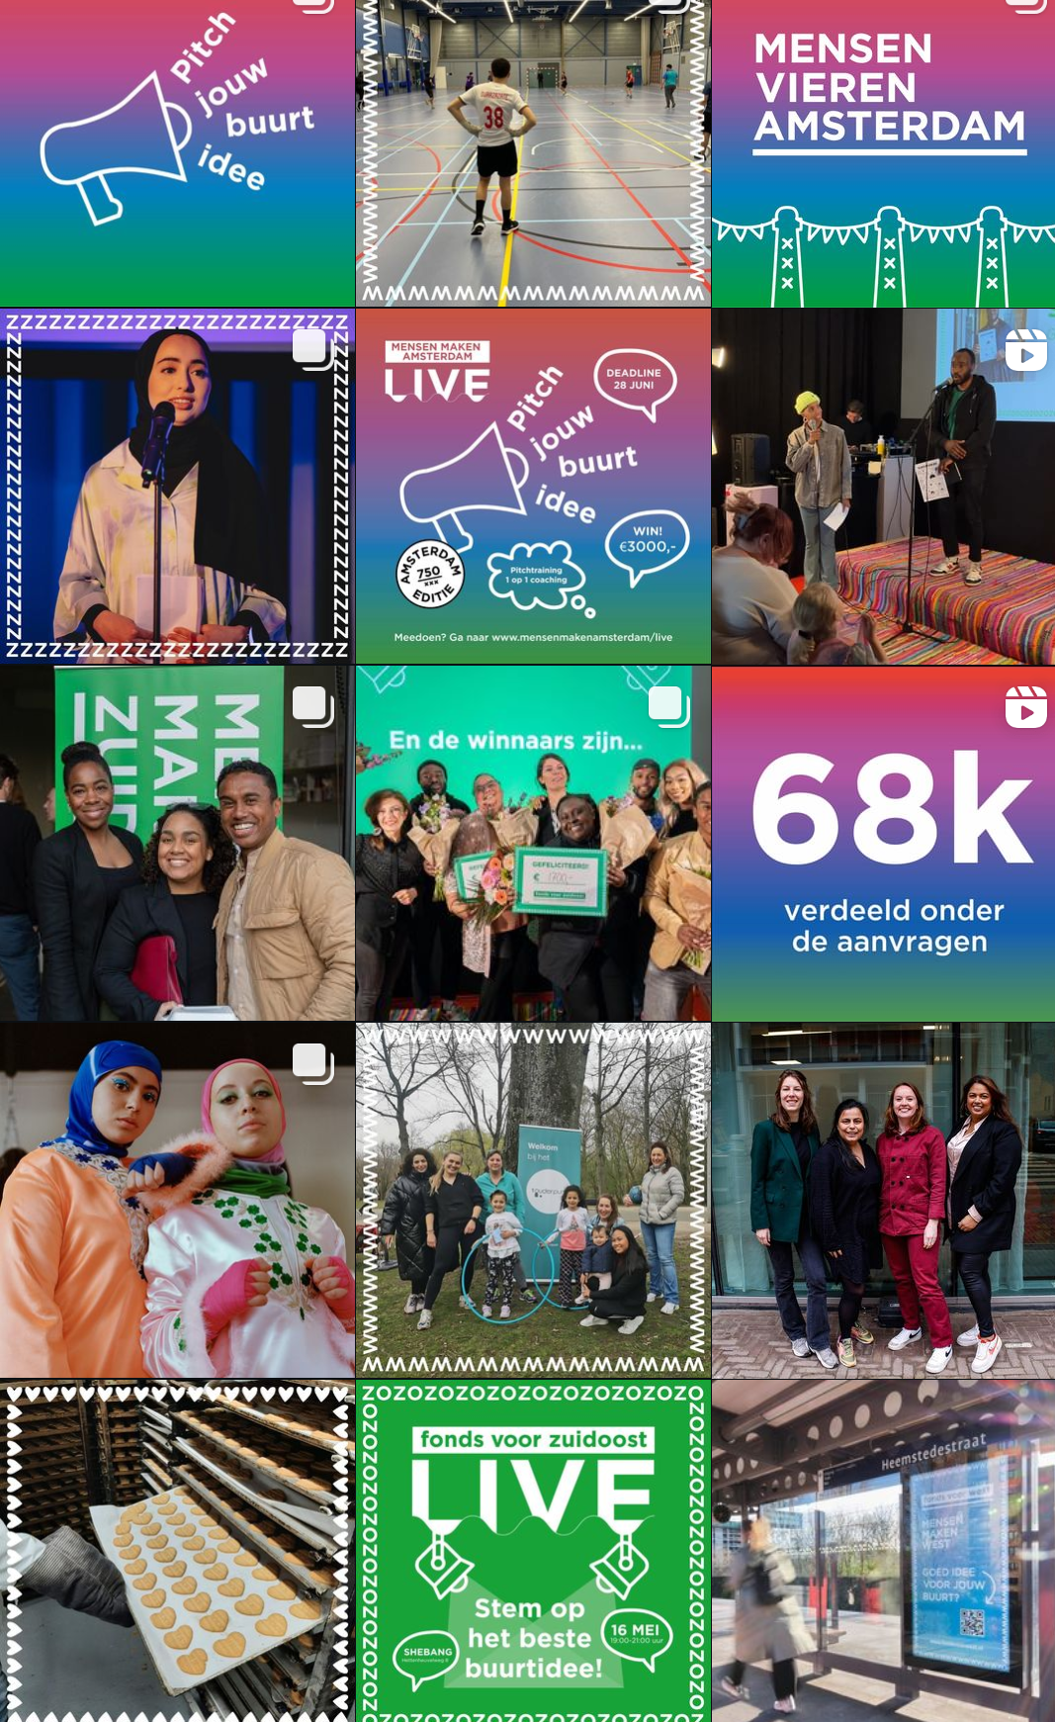
Happy faces in return

Slide 6
How it all began...

Slide 7
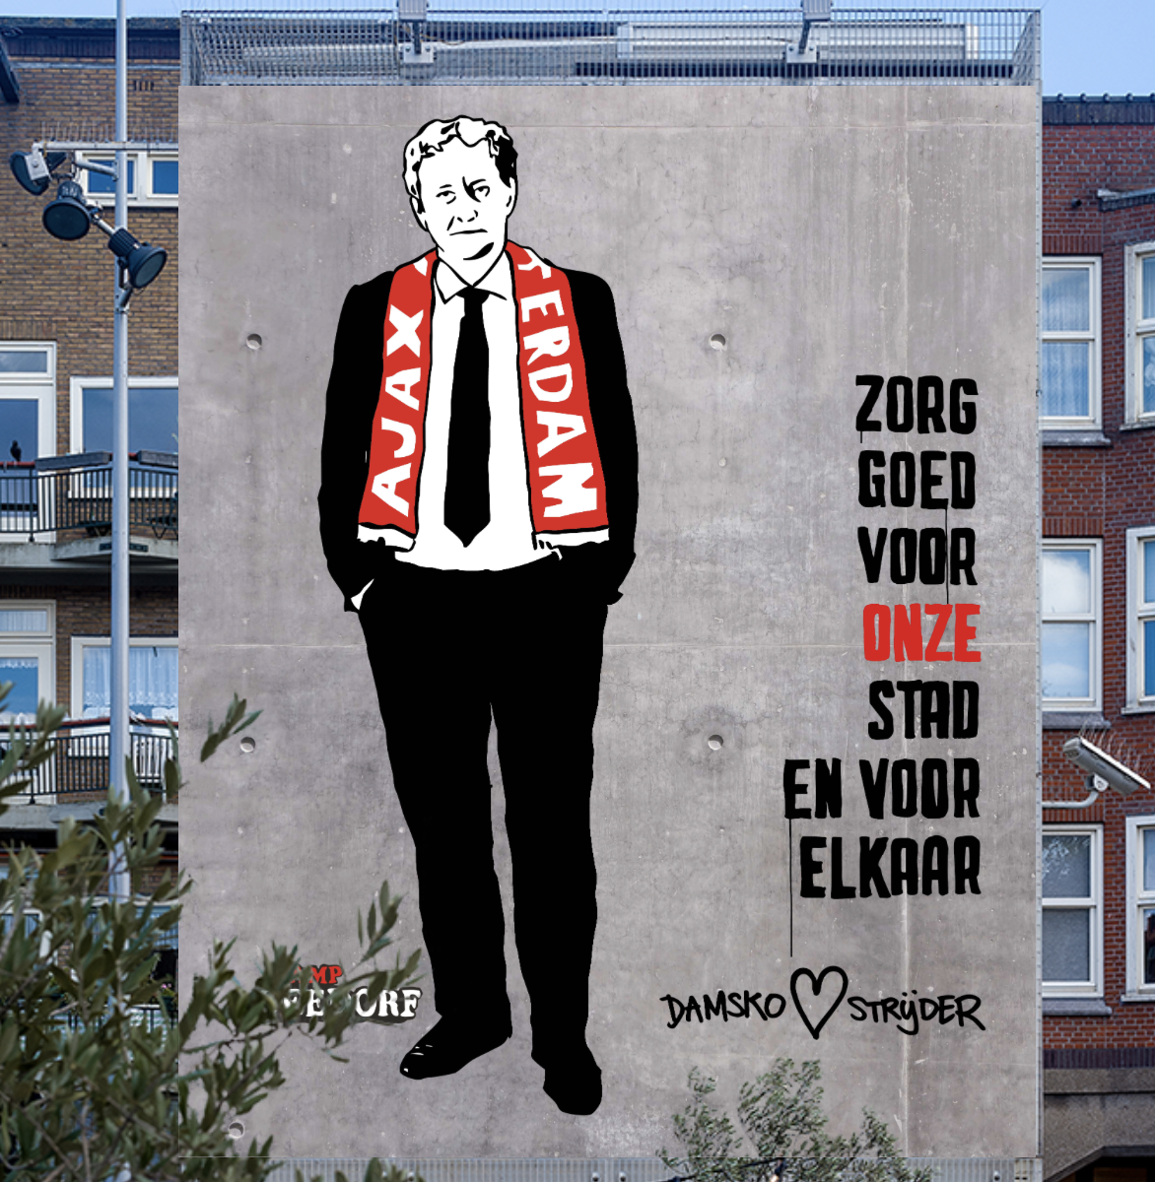
“Please take good care of our city and of each other. Farewell”​
​Eberhard van der Laan (*) 28-06-1955 † 5-10-2017
Mayor of Amsterdam in 2010 – 2017
Notes:
Résa:
Transparantie
Eenvoud / laagdrempeligheid
Simpel contact: kopje koffie met een koekje
Open staan voor anderen
Saamhorigheid – ongeacht achtergrond – gedeeld verdriet
Positiviteit

Slide 8
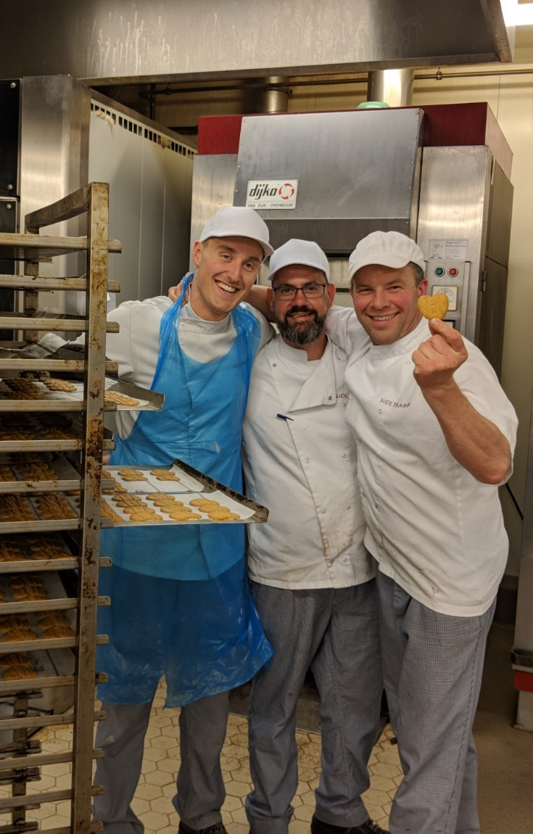
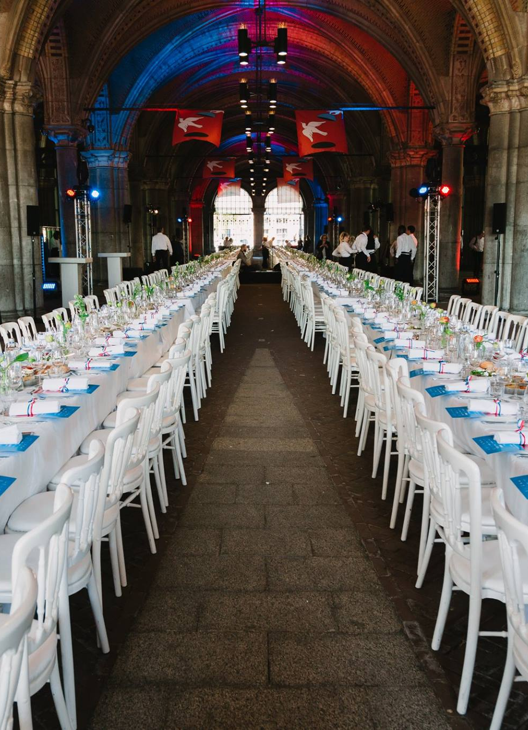


Slide 9

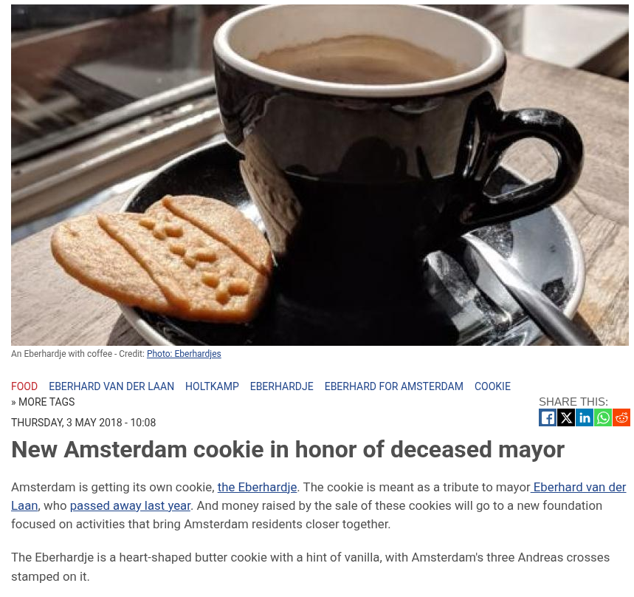
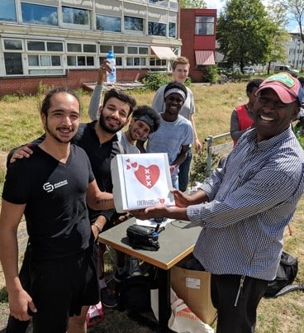
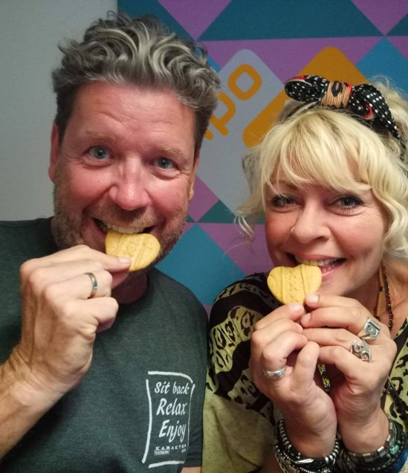

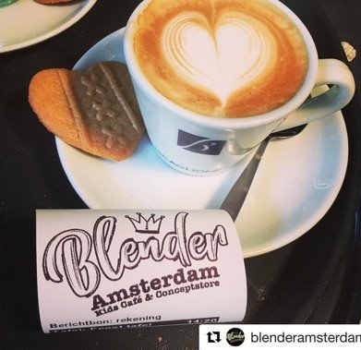


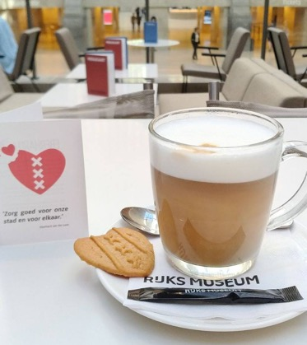

Our succesful launch: a combination of factors
Momentum – great partners – PR - visibility – happy faces - recognition

Slide 10
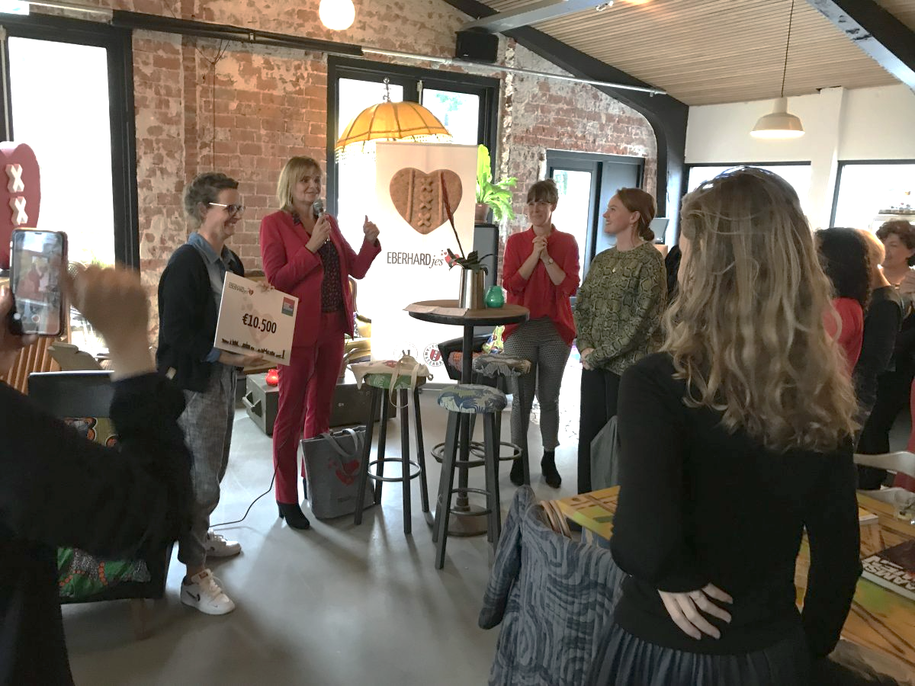

Notes:
Community funding
Easy acces
Stimulate coherence in the neighborhood
Focusing on a more livable and social city

Slide 11
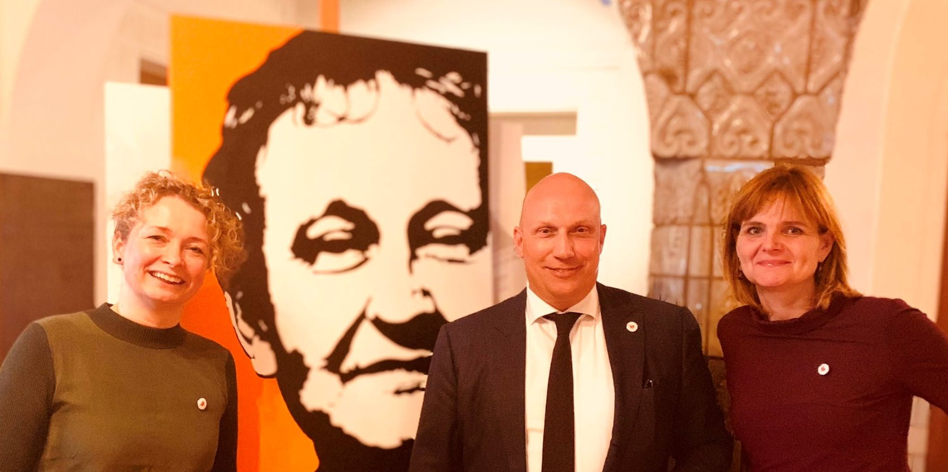
Our mantra's
Think big – act small
Yes we can
Take less to give more – doing good is contagious
Hocus pocus focus
It has to stay fun
Slow but steady
Patience is a virtue

Slide 12
Facts and figures 2018 - 2025

Slide 13

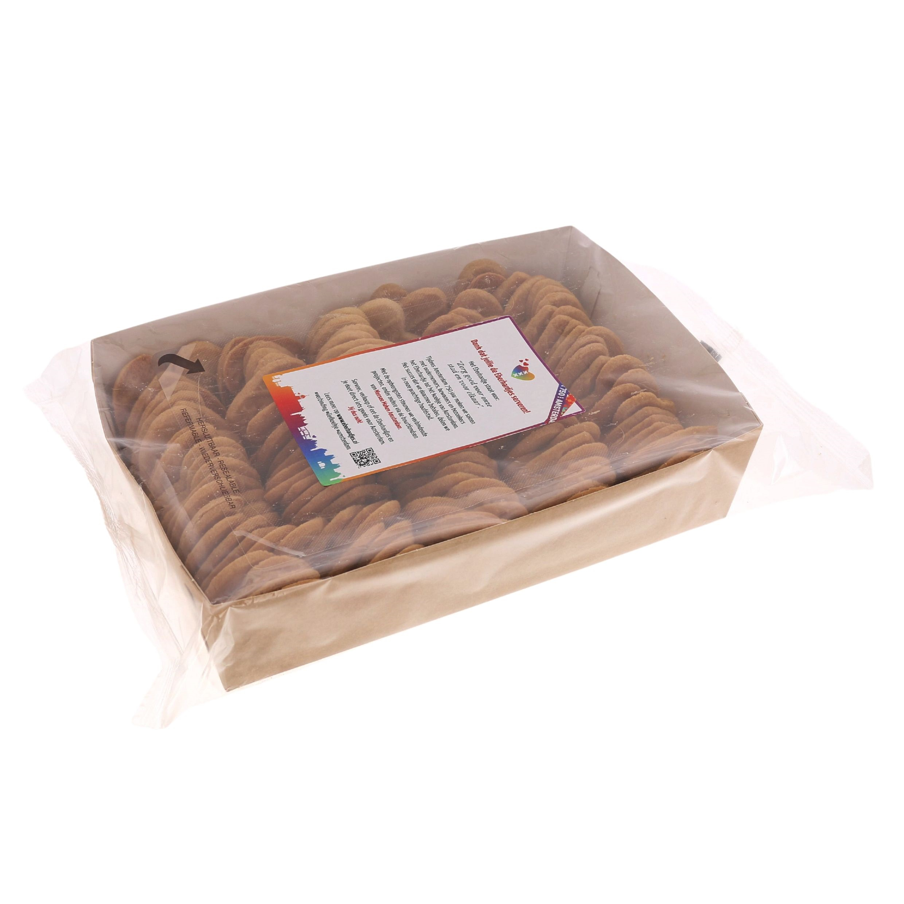
Our cookies served the hospitality industry
Notes:
In various restaurants, café's, hotels, museums

Slide 14
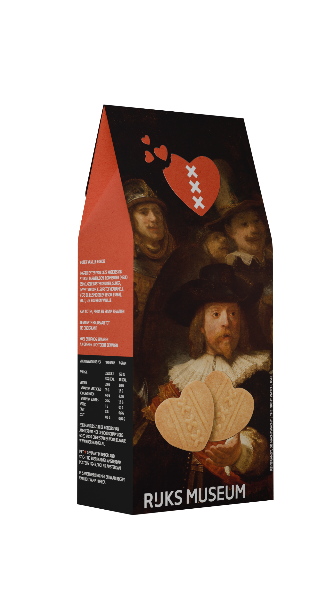


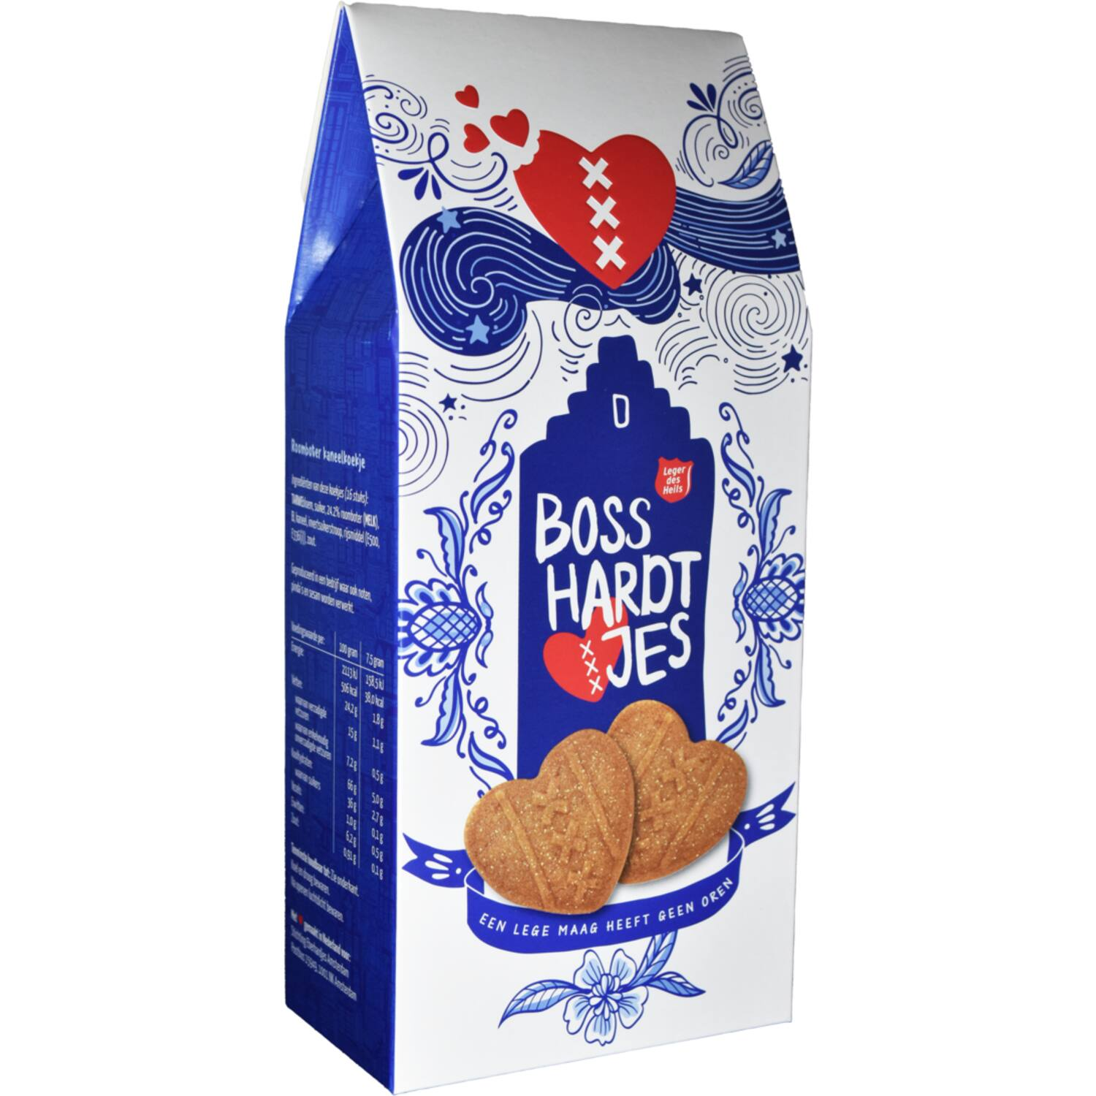
The result of our activities for the retail business
Notes:
In all kinds of shops for sale but also as a gift to VIPS in hotels or at events – as a thank you present

Slide 15

Facts and sales of Eberhardjes in kilo's 2018 - 2024
1.000.000 Eberhardjes sold + 10.500 to local projects MMA!
Steady growth...
Same results as in 2019
Flying start as thé cookie of Amsterdam
End of Covid
Growth of locations
COVID
Q2 – Q4 2020 no income
Covid
New production line + product
Our own shop
Grow professionally
Notes:
Vliegende start 2018 en 2019 > 1000 kilo koek per maand
Start Corona periode 2020 > 0 kilo koek per maand (3x!)
Tijdens Corona crowdfunding consumentenverpakking
Kleine eigen investering en professionaliseringsslag (eigen wals, verpakking professionaliseren, stichting verzelfstandigen)
Groei aantal verkooppunten
Opening eigen locatie op de Oudezijds Voorburgwal 74
Corona-periode overleefd
Vanaf 2023 weer een grotere stijging in verkoop
In 2024 zet de groei door…

Slide 16
This is how we grow
Focus on selling more cookies
Develop new products - together with strong partners
Constant visibility with highlights
Growth of our network with entrepeneurs, local ambassadors and visitors of Amsterdam
Notes:
We leggen de basis voor een steeds groter assortiment wat we mét elkaar in de markt zetten om goed te doen.
We grow to do good

Slide 17
Our challenges and failures
Notes:
=

Slide 18
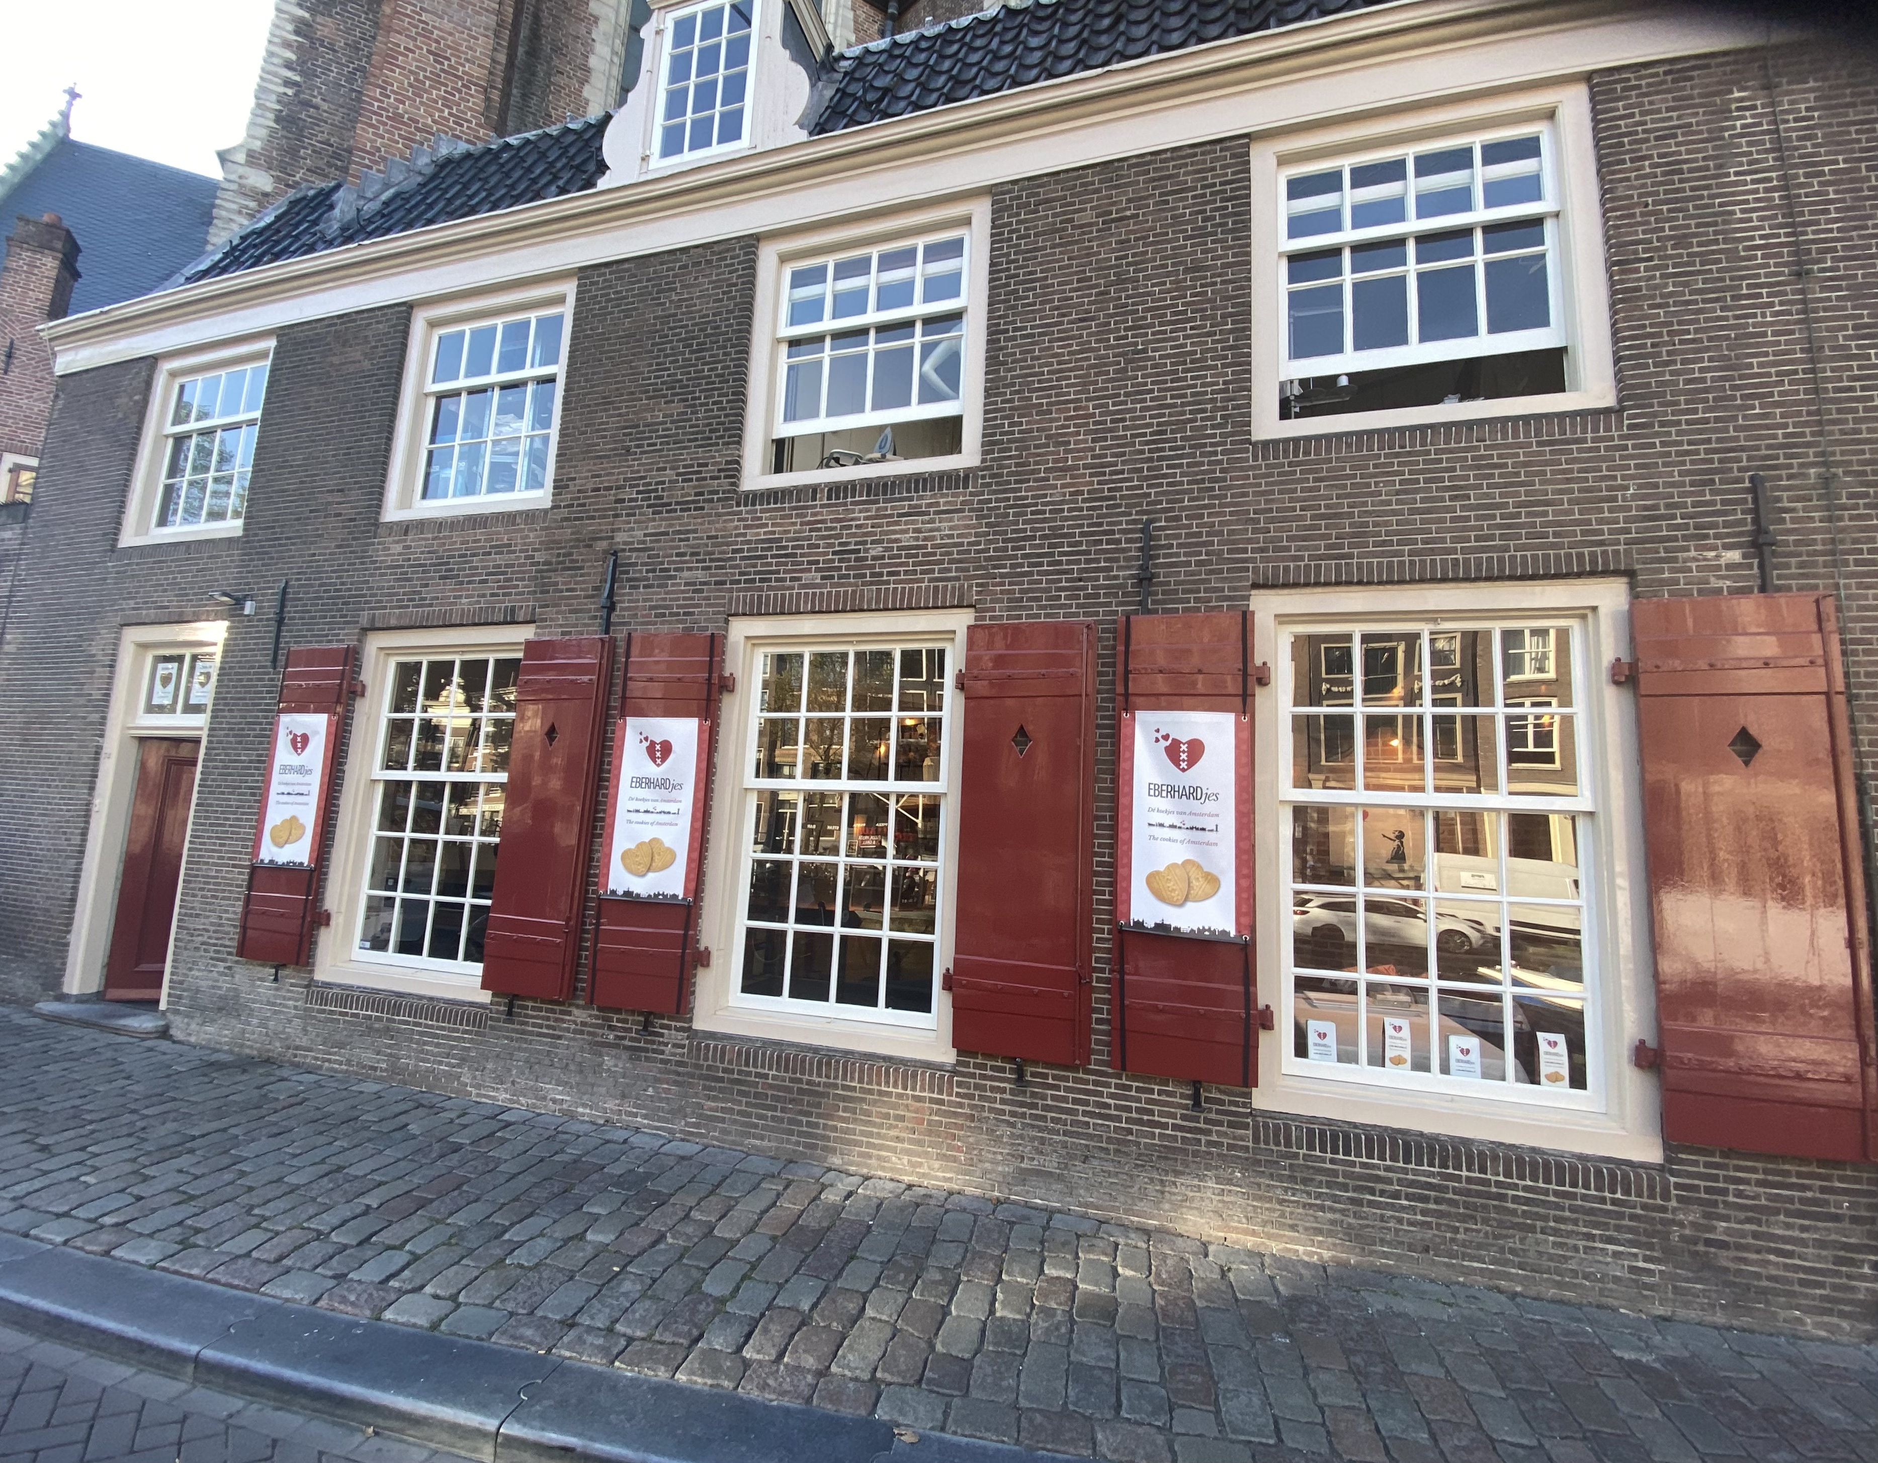
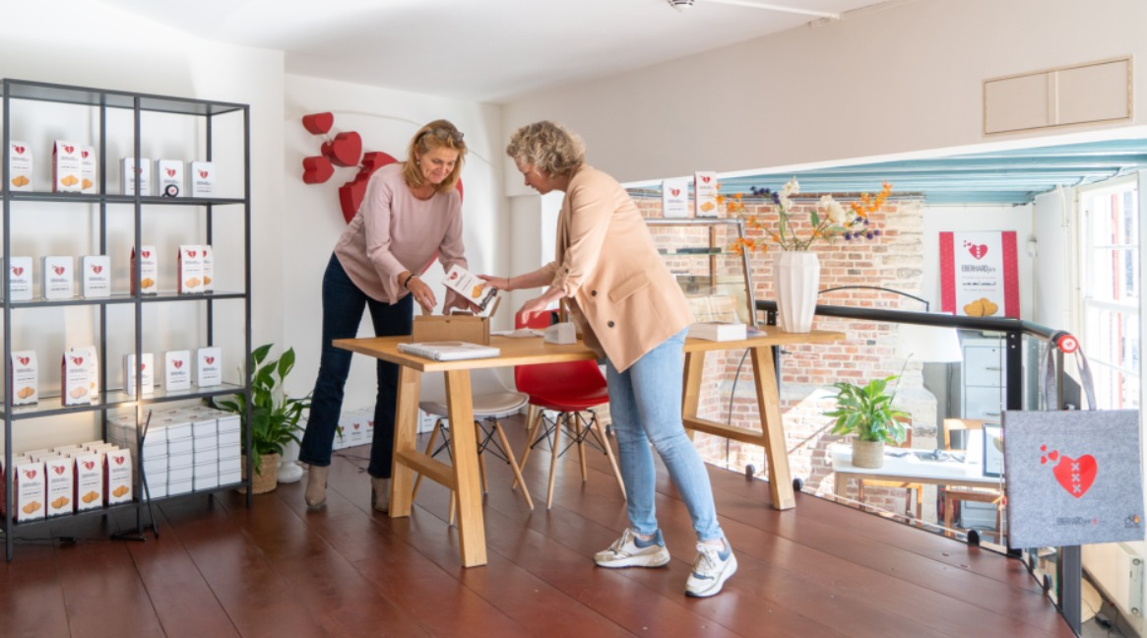
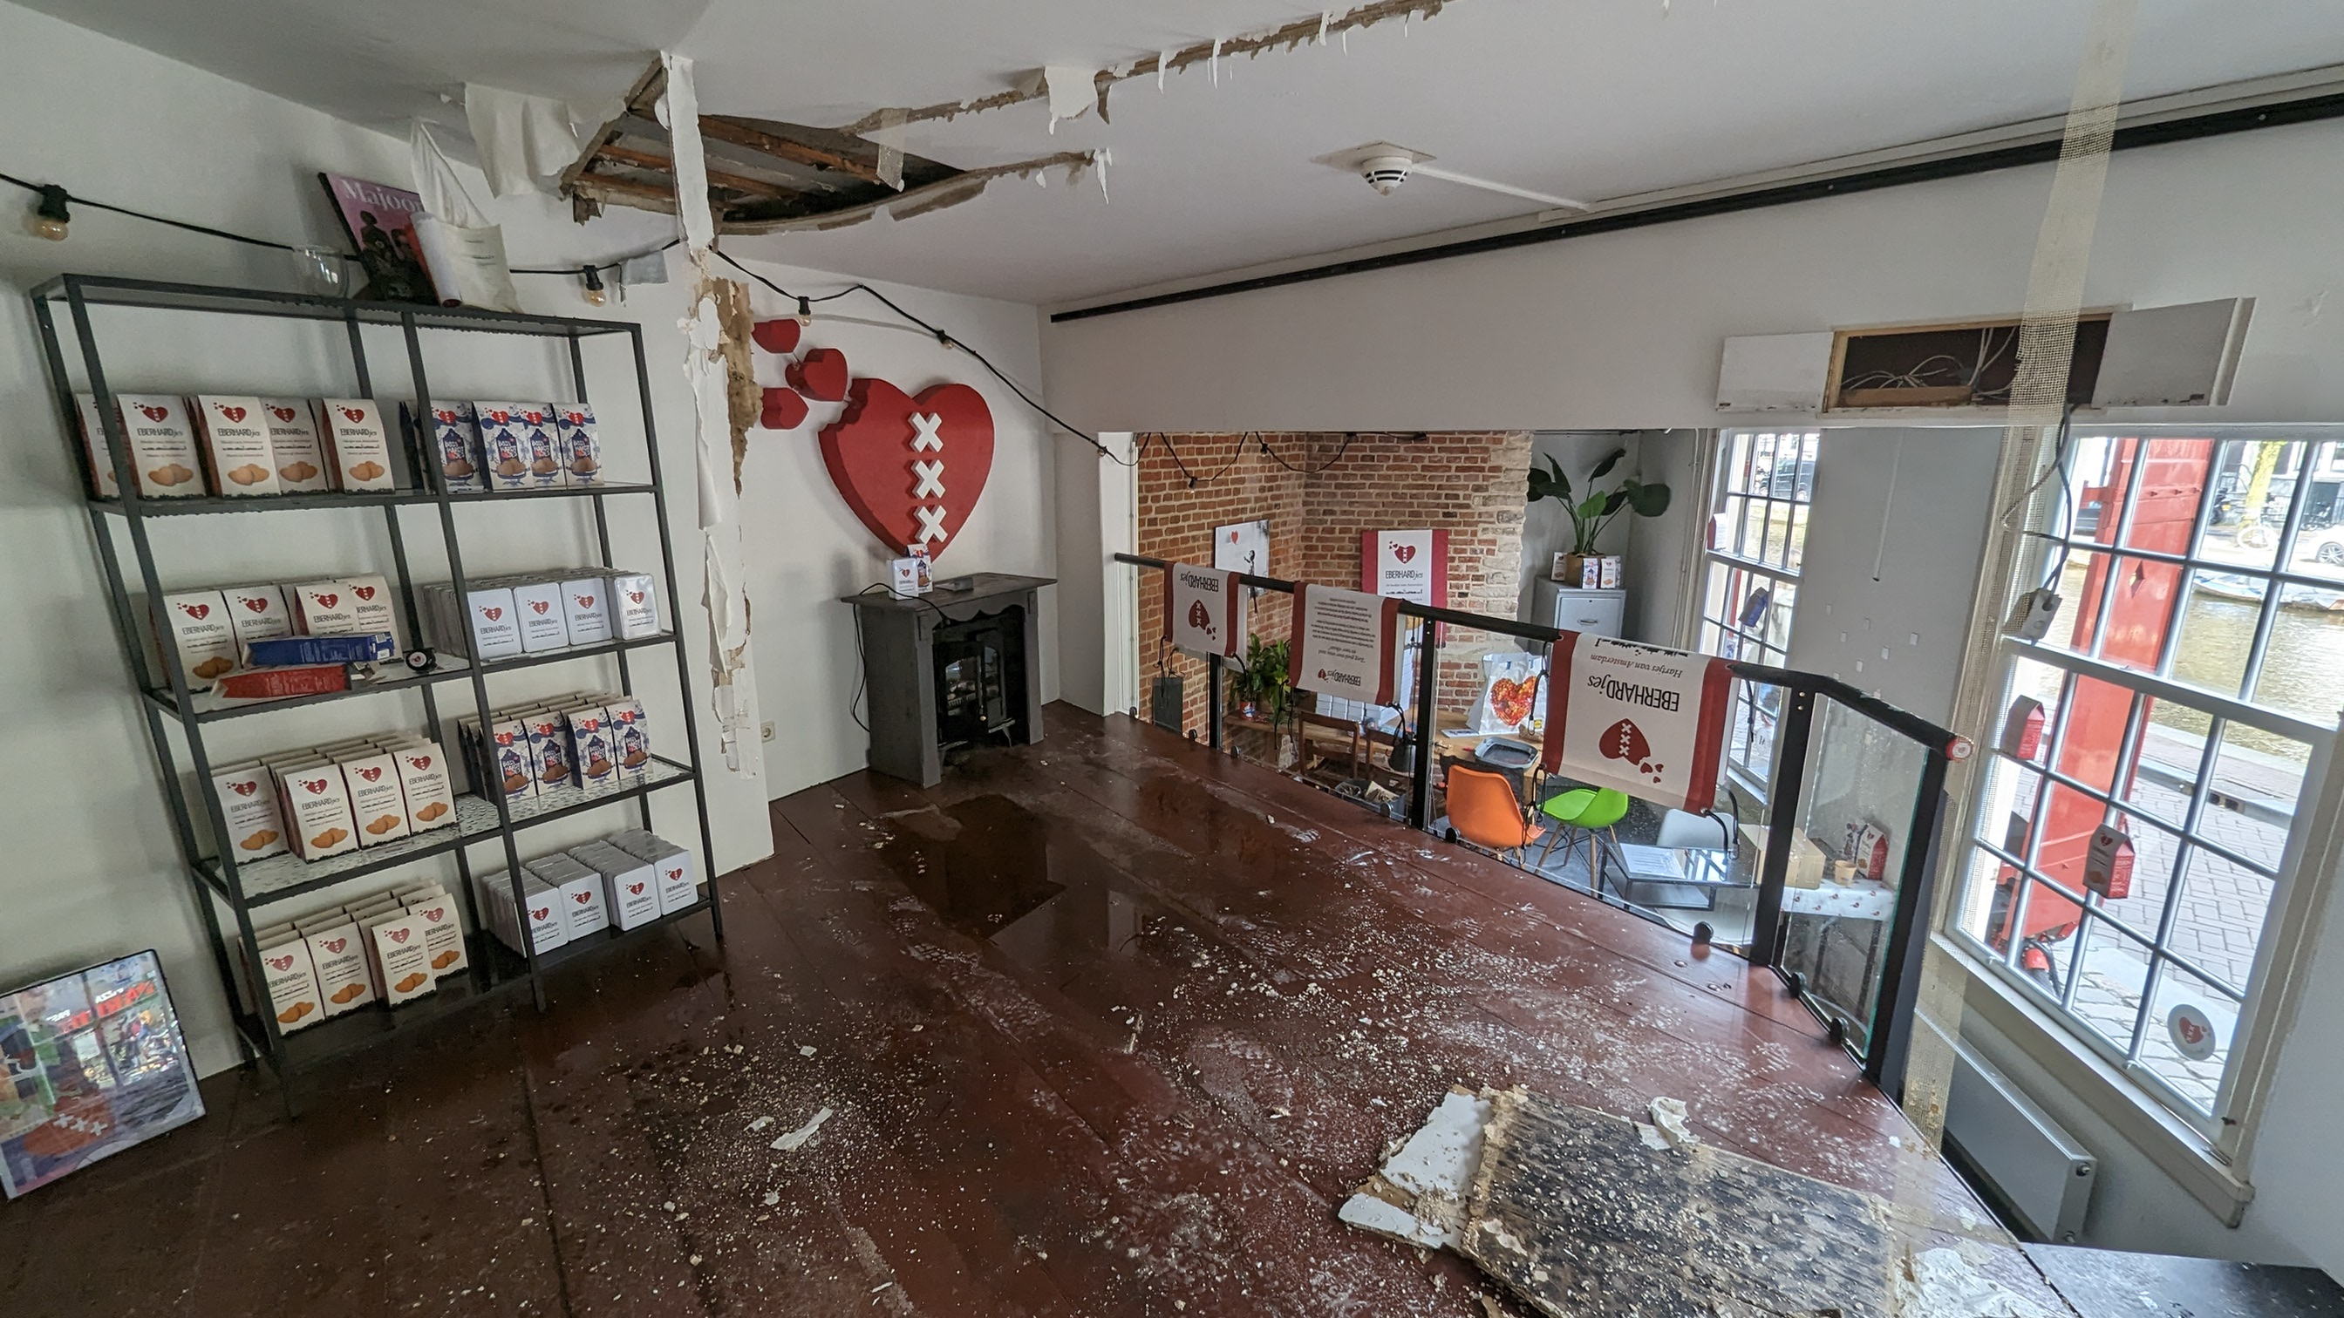
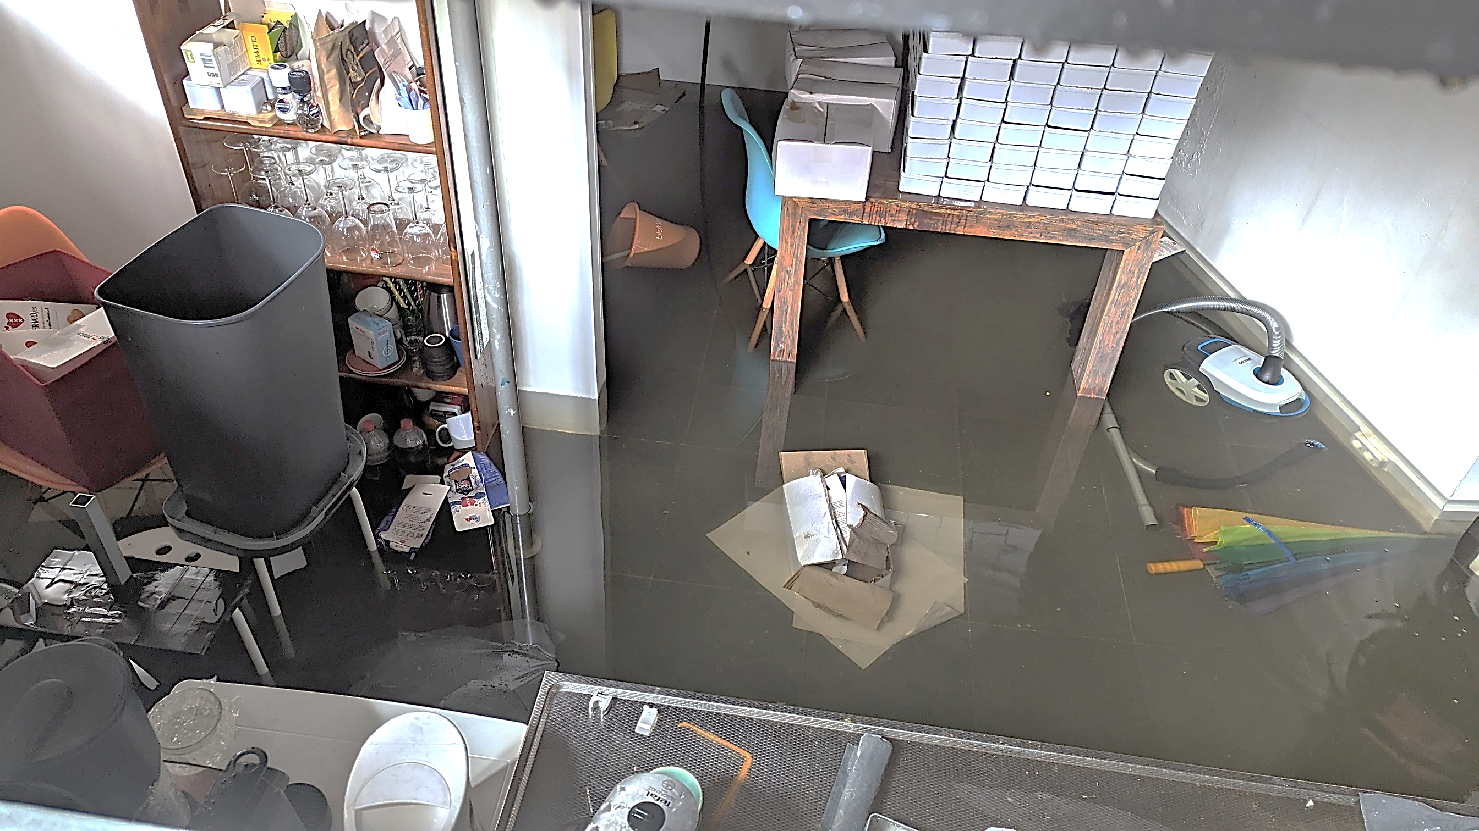
Our challenges...
COVID-19 pandemic: complete drop in sales (Q2–Q4 2020)
Severe water damage: shop inventory total loss (May 2024)
Growing pains: scaling from start-up spirit to professional structure

Slide 19
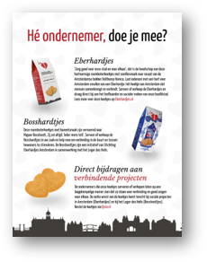
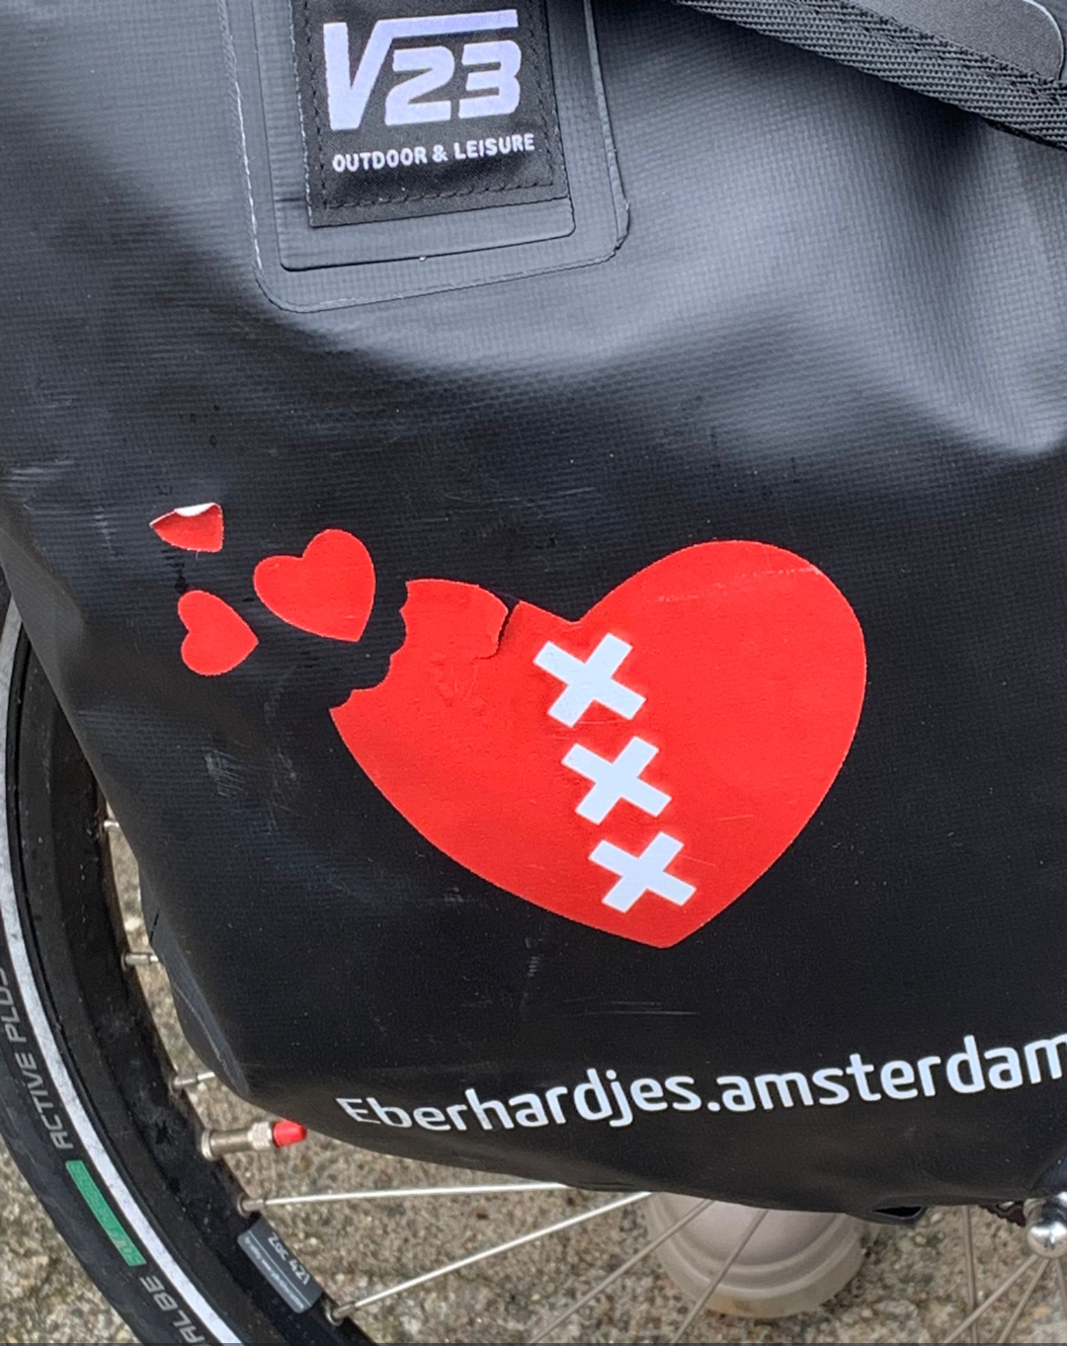
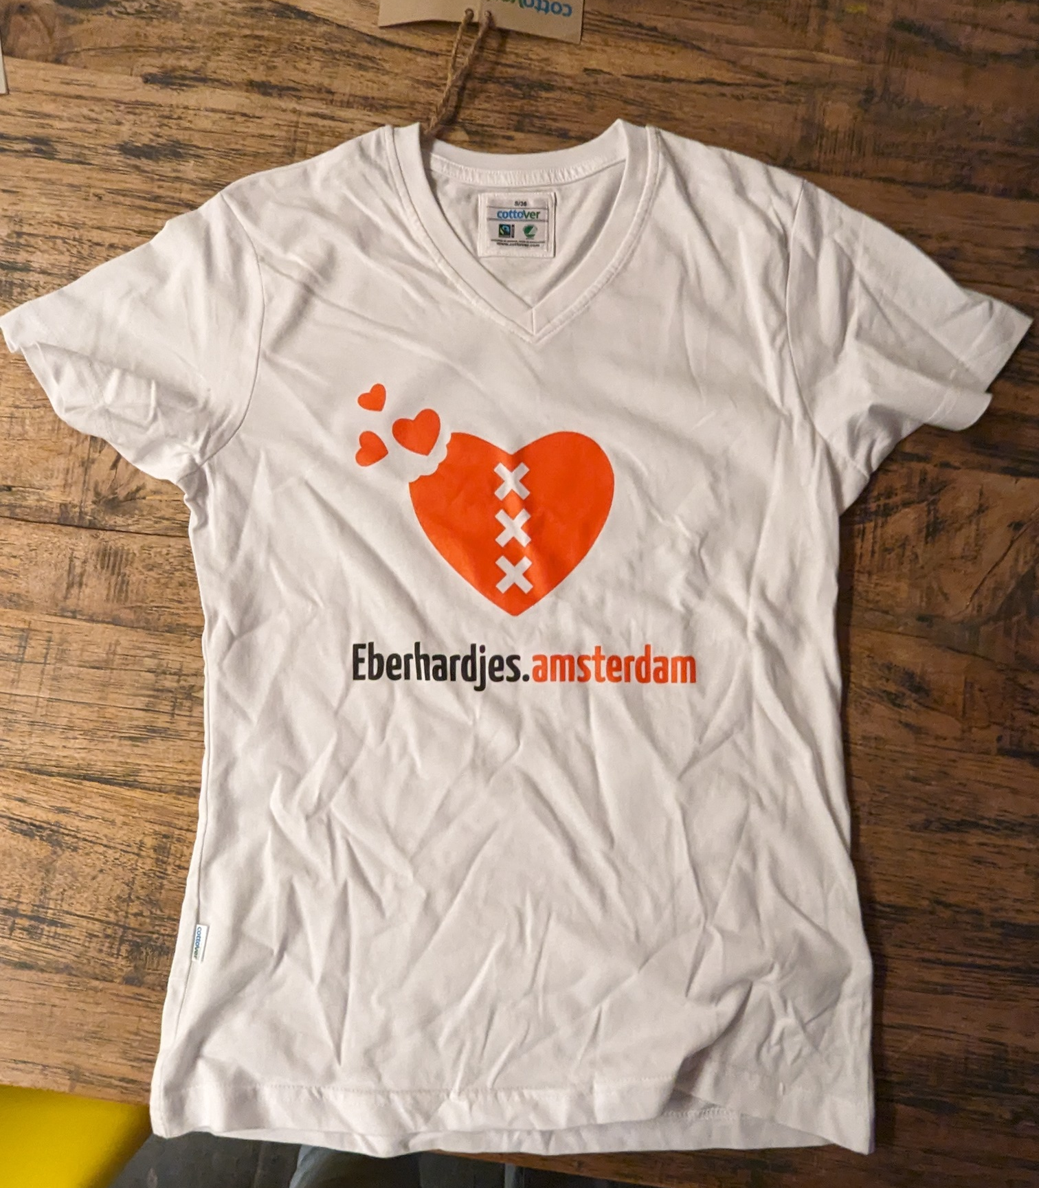
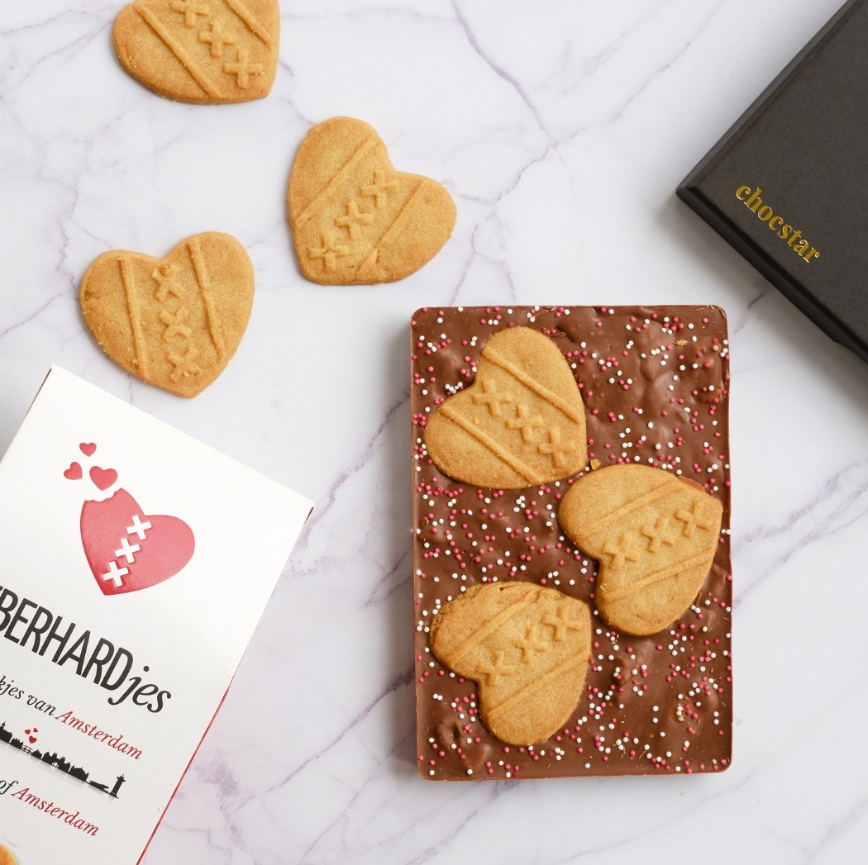
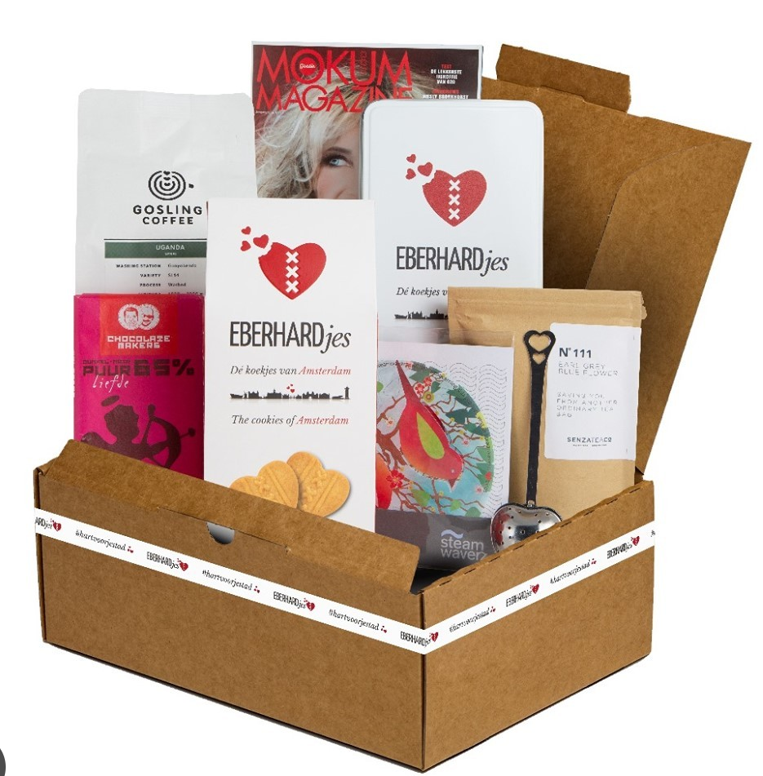
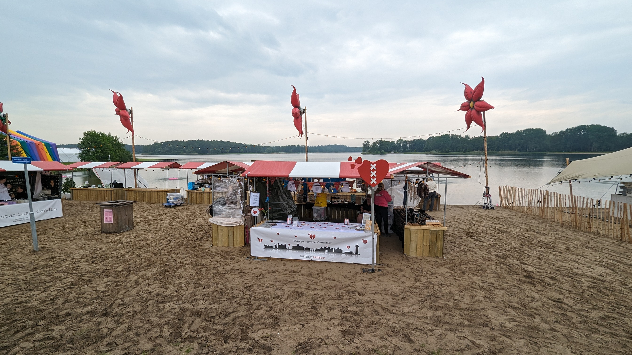
Our ‘failures’...
Buying merchandise without certainty of sales
Create new products and campaigns on the side that take a too high investment on time and money
Invest in marketing and sales with little impact
Say yes to attending events that do not fit us and cost way too much time
Apply for funding at the local government of Amsterdam
Start co-operation on trust and 'believe in a good cause' causing taking a big risk for our small organization.... >>>

Slide 20

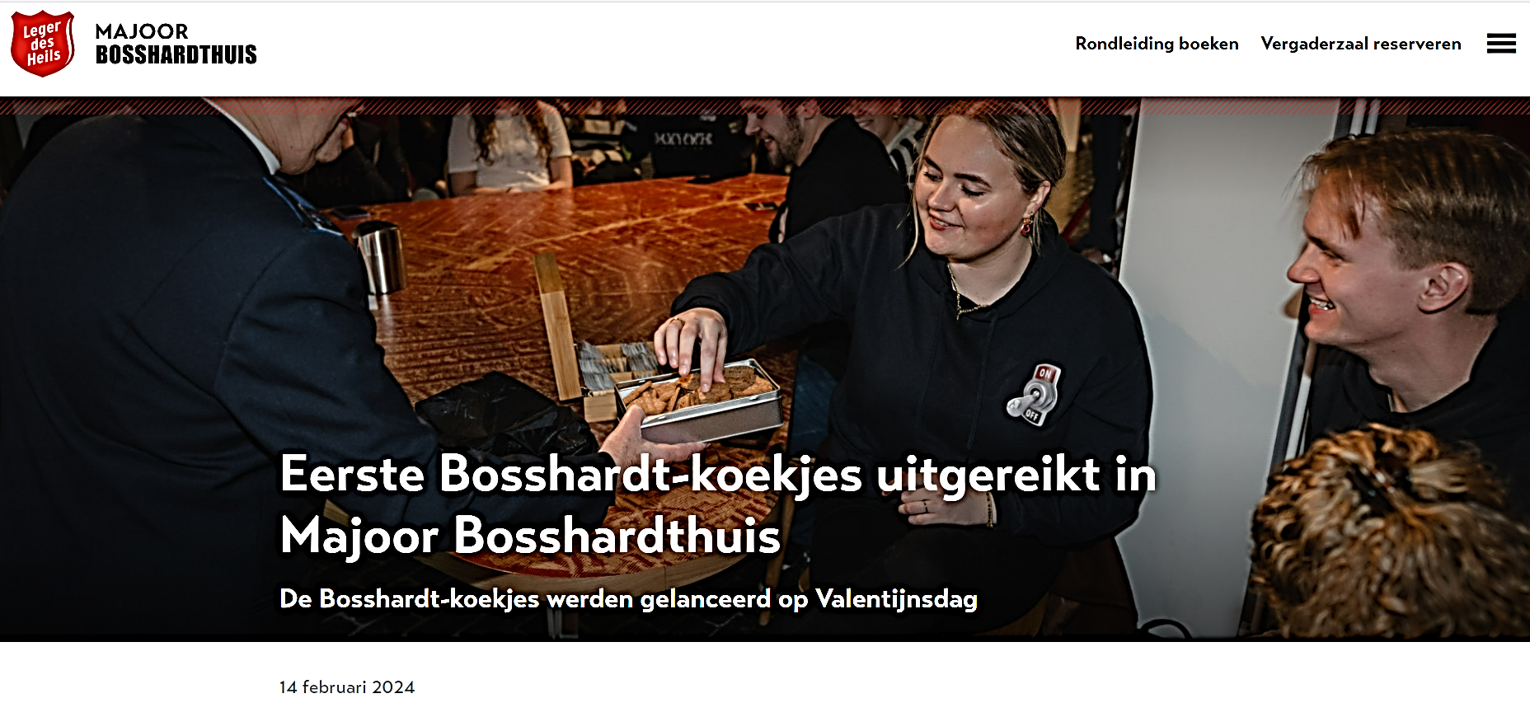
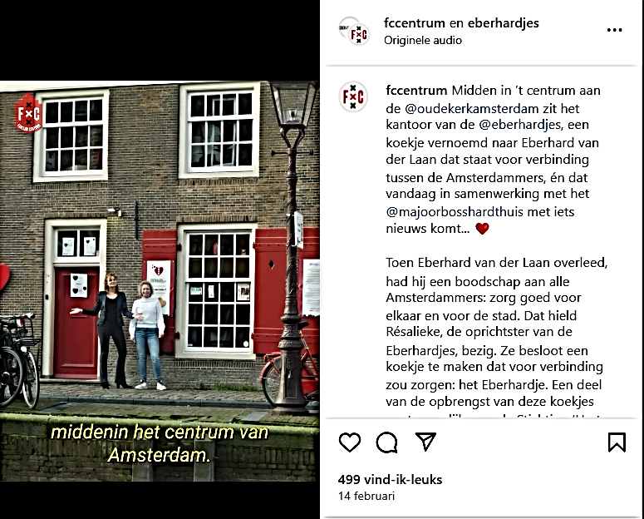
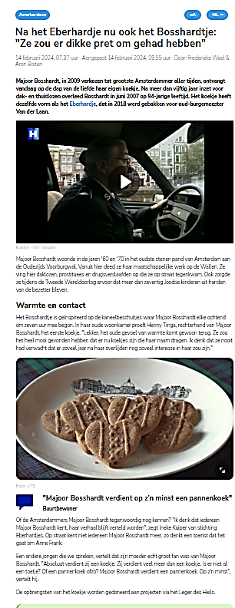
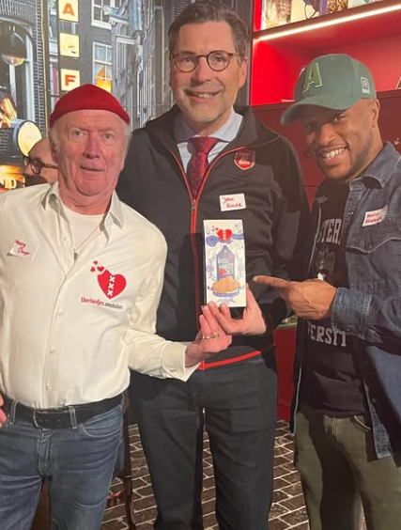
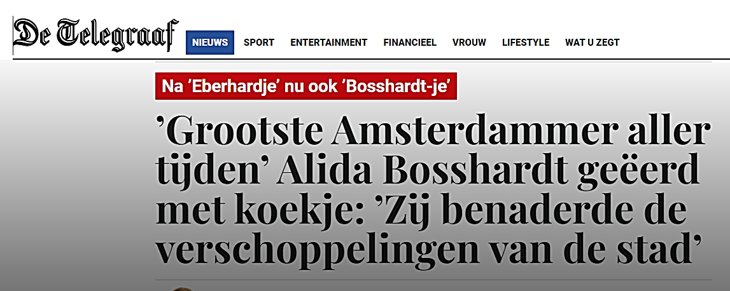

Yeah!
It's a girl!
Shared values and enthousiasm created a new cookie!

Slide 21
What went wrong?
Different expectations: entrepreneurial vs. traditional approach
No internal project ownership within the Salvation Army
Limited commercial drive and agility
Lack of continuous marketing and communication efforts
Eberhardjes carried all the risks; no shared investment
Notes:
What Went Wrong with the Salvation Army Collaboration?
Mismatch in expectations:
Stichting Eberhardjes assumed shared entrepreneurial ownership and active communication. However, the Salvation Army operates as a more traditional, hierarchical organization, less commercially driven and slower in decision-making.
No clear internal ownership:
No dedicated project owner was appointed within the Salvation Army, which caused momentum and communication to fade after the launch.
Limited commercial capabilities:
The Salvation Army is mission-driven and lacks the agility and expertise needed to commercially grow a product.
No structured marketing and communication plan:
After a strong media launch, there was no ongoing communication to support and sustain product demand.
Different risk profiles and priorities:
Stichting Eberhardjes carried all the risk (inventory, production costs), while the Salvation Army had no financial urgency to invest or push the project further.
Wat is er misgegaan in het traject met het Leger des Heils?
Verschillende verwachtingen:
Stichting Eberhardjes ging uit van een gedeeld ondernemend eigenaarschap en actieve communicatie. Het Leger des Heils bleek veel meer een klassieke, hiërarchische organisatie te zijn, minder commercieel en met trage besluitvorming.
Geen heldere interne verantwoordelijkheid bij Leger des Heils:
Er werd niemand écht ‘eigenaar’ van het Bosshardtjes-project binnen de organisatie. Zonder een intern aanspreekpunt viel de opvolging en marketing stil.
Beperkte commerciële slagkracht:
Het Leger des Heils heeft weinig ervaring en capaciteit om producten commercieel in de markt te zetten. Verkoop en marketing vereisen snelle, proactieve inzet, iets wat in hun structuur lastig bleek.
Geen structureel marketing- en communicatieplan:
Na de initiële lancering (met veel media-aandacht) ontbrak structurele communicatie om vraag en zichtbaarheid op peil te houden.
Andere prioriteiten en risicoperceptie:
Stichting Eberhardjes nam alle risico’s (voorraad, kosten). Het Leger des Heils had geen urgentie om in te zetten op groei of investering in het product.

Slide 22
Fundamental Differences
Stichting Eberhardjes | Salvation Army
Entrepreneurial & creative | Bureaucratic & mission-driven
Fast, pragmatic actions | Slow decision-making processes
Commercial growth mindset | Focus on social programs
Small, flexible team | Large, hierarchical organization
Notes:
Entrepreneurial & creative vs Bureaucratic & mission-driven
Fast, pragmatic actions vs Slow decision-making processes
Commercial growth mindset vs Focus on social programs
Small, flexible team vs Large, hierarchical organization
==
Fundamentele verschillen tussen Stichting Eberhardjes en Leger des Heils
Stichting Eberhardjes vs Leger des Heils
Ondernemend en flexibel vs Bureaucratisch en hiërarchisch
Snel schakelen, pragmatisch vs Trage besluitvorming, interne afstemming vereist
Commercieel ingesteld vs Niet-commercieel, missiegedreven
Focus op creatieve groei vs Focus op stabiliteit en bestaande structuren
Kleine, wendbare organisatie vs Grote, logge organisatie

Slide 23
Why we chose to collaborate with the Salvation Army
We believed in shared values: connection, compassion, and social responsibility
The Salvation Army is a respected name — powerful both symbolically and practically
We saw a chance to create something meaningful together, not just a product
Connection with our teammembers from the start
Some individuals within the organization were true believers from day one — and still are
Still proud 'parents' of this cookie – we showed it was possible – yes, we can...
Notes:
Why we chose to collaborate with the Salvation Army
We believed in shared values: connection, compassion, and social responsibility
The Salvation Army is a respected name — powerful both symbolically and practically
We saw a chance to create something meaningful together, not just a product
Connection with our teammembers from the start
Some individuals within the organization were true believers from day one — and still are
Waarom we de samenwerking met het Leger des Heils zijn aangegaan
We geloofden in gedeelde waarden: verbinding, compassie en maatschappelijke impact
Het Leger des Heils is een naam met gewicht – krachtig qua uitstraling én bereik
We zagen een kans om samen iets betekenisvols te maken, méér dan alleen een koekje
Binnen de organisatie zijn mensen die vanaf het begin mee hebben gedacht – en dat nog steeds doen
Ondanks alle uitdagingen staat er nu iets – dat was anders niet gelukt
De Bosshardtjes zijn een voorbeeldproject, en kunnen de drempel verlagen voor toekomstige samenwerkingen
We leerden: bij een grote organisatie moet je niet wachten tot alles geregeld is, maar beginnen
Het koekje is geboren – nu vraagt het nog tijd, zorg en gezamenlijke opvoeding 😉

Slide 24
What did we learn for future collaborations?
Don't be too quickly impressed
Check the commercial mindset and flexibility of the partner beforehand
Appoint a clear internal project owner who has time, budget, and decision-making authority
Define expectations explicitly: roles, responsibilities, marketing commitments, and risk sharing
Create ongoing joint communication and sales plans, not just a launch campaign
Agree on exit strategies in case the collaboration does not evolve as planned
Notes:
What did we learn for future collaborations
Don't be too quickly impressed
Check the commercial mindset and flexibility of the partner beforehand
Appoint a clear internal project owner who has time, budget, and decision-making authority.
Define expectations explicitly: roles, responsibilities, marketing commitments, and risk sharing.
Create ongoing joint communication and sales plans, not just a launch campaign.
Agree on exit strategies in case the collaboration does not evolve as planned.
Lessen voor toekomstige samenwerkingen (bijvoorbeeld met Rijksmuseum)
Zorg voor een heldere interne ‘eigenaar’ bij de partnerorganisatie, met tijd, budget en mandaat.
Check vooraf de commerciële mentaliteit en flexibiliteit: kunnen/mogen ze überhaupt commercieel denken en handelen?
Maak verwachtingen expliciet: rollen, verantwoordelijkheden, communicatie-inzet en risicoverdeling.
Plan structurele communicatie- en verkoopmomenten samen (niet alleen lanceren, maar ook onderhouden).
Bouw exit-strategieën in: hoe los je het op als het niet loopt zoals gehoopt?

Slide 25
However... mistakes are milestones towards impact
If we hadn't caught on the way we did, the cookie would not have been there​
Sometimes it is necessary to take a risk, in order to make progress​
We now know even better that the main aim of the team is connection and progress ​
You never know what the future brings... ​
Notes:
Every setback sharpened our focus, strengthened connections, and deepened our purpose.
If we hadn't caught on the way we did, the cookie would not have been there
Sometimes it is necessary to take a risk, in order to make progress
We now know even better that the main aim of the team is connection and progress
You never know what the future brings...

Slide 26
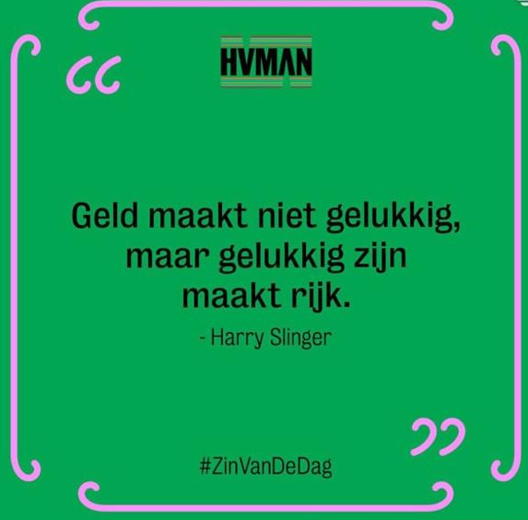
Doing good is contagious
Continuing growth
  growth of locations that serve and sell
  more cookies sold – efficient logistics for more profit
  more variation – together with partners
More visibility
Co-operation with experienced partners for merchandise
Stabilisation and growth of our social organization
'Every partner takes less in order to give more'
Growth of our funding budget – more donations and more support for local projects
Maybe add a new mantra: 'Grow with grace – connect with care'
Notes:
Continuing growth
growth of locations that serve and sell
more cookies sold – efficient logistics for more profit
more variation – together with partners
More visibility
Co-operation with experienced partners for merchandise
Stabilisation and growth of our social organization
'Every partner takes less in order to give more'
Growth of our funding budget – more donations and more support for local projects

Slide 27



Thank you for your attention!
Have a cookie!
Follow us via:
@Eberhardjes

Slide 28
Bijlage voor evt aanvullende info

Slide 29
Our current campaign to focus on the good

Slide 30
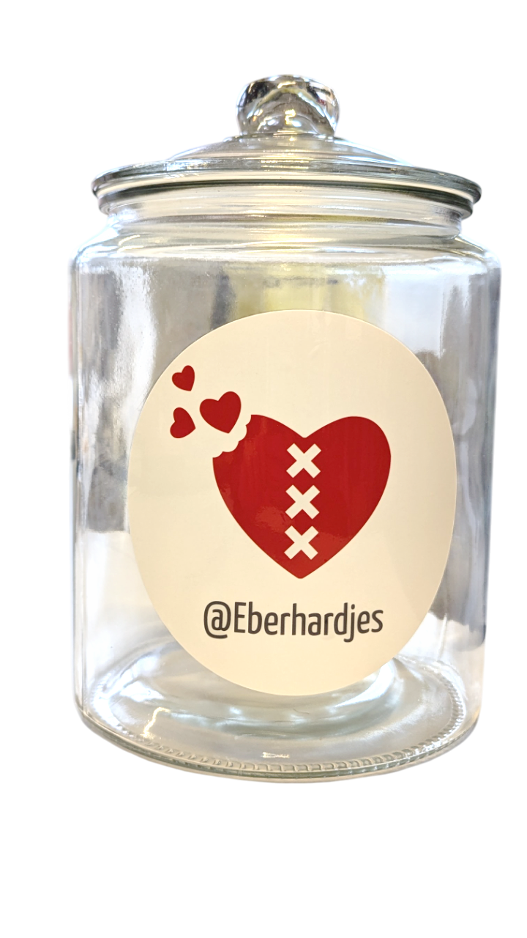




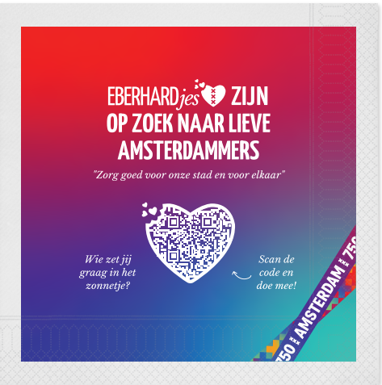
Een actie vanuit verbinding…
Posters
Free-cards
Viltjes
Servetten
Notes:
Geen grote marketing budgetten
Maar… succes vanuit verbinding!
Wij leveren een kant en klare actie aan voor al onze afnemers om op te vallen tijdens het 750 jubileumjaar!

Slide 31
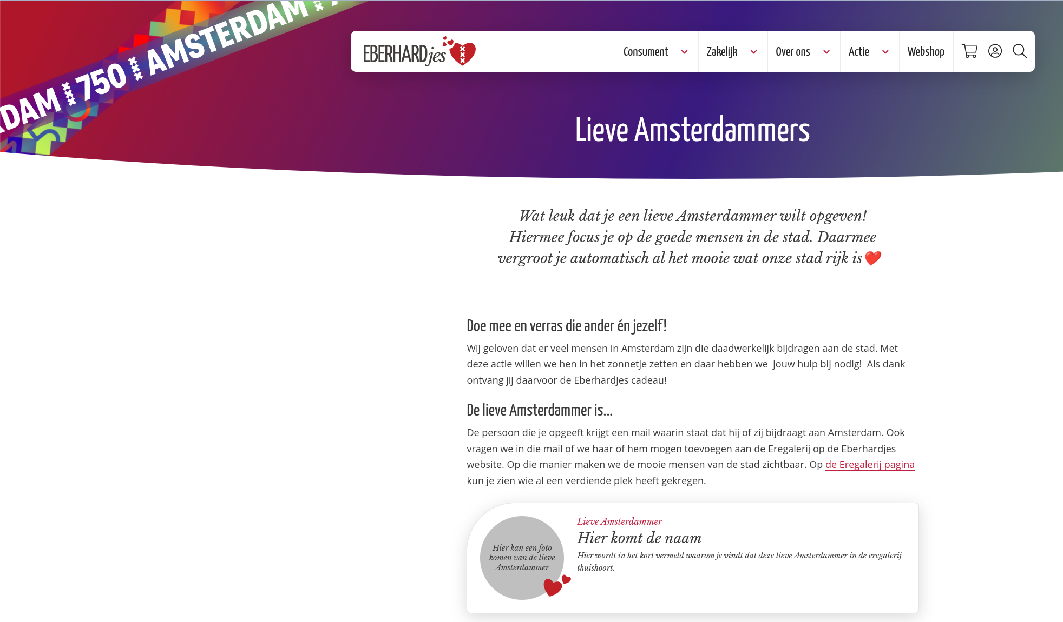
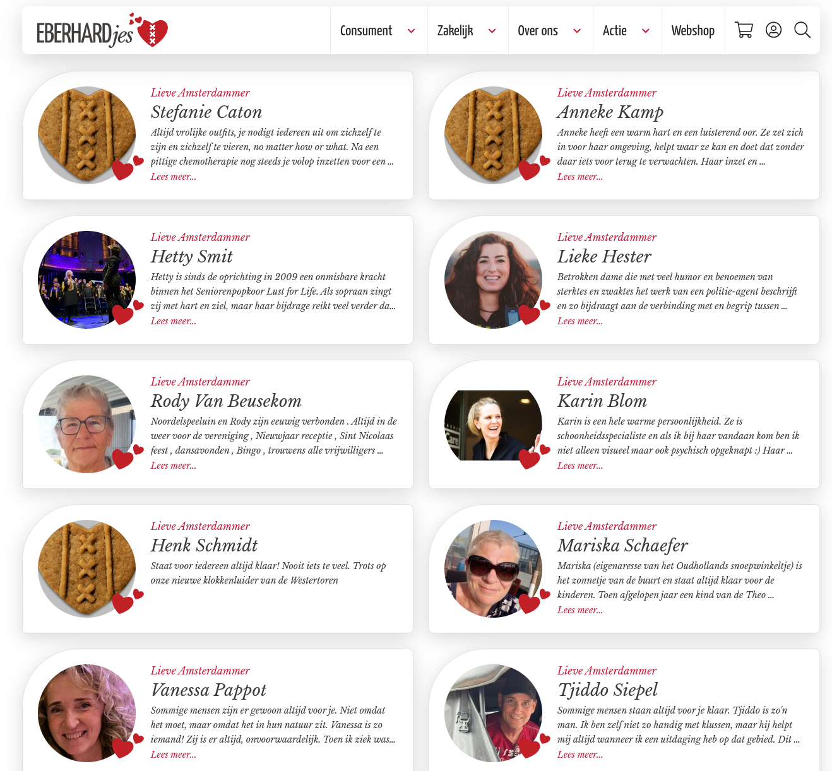

Slide 32
Our locations

Slide 33































Where to go to try out the Eberhardjes
Notes:
Trots op alle namen die hier tussen staan

Slide 34


















Where to buy the Eberhardjes
Notes:
Positief combinatie proeven en kopen
Groei, ook voor events

Slide 35

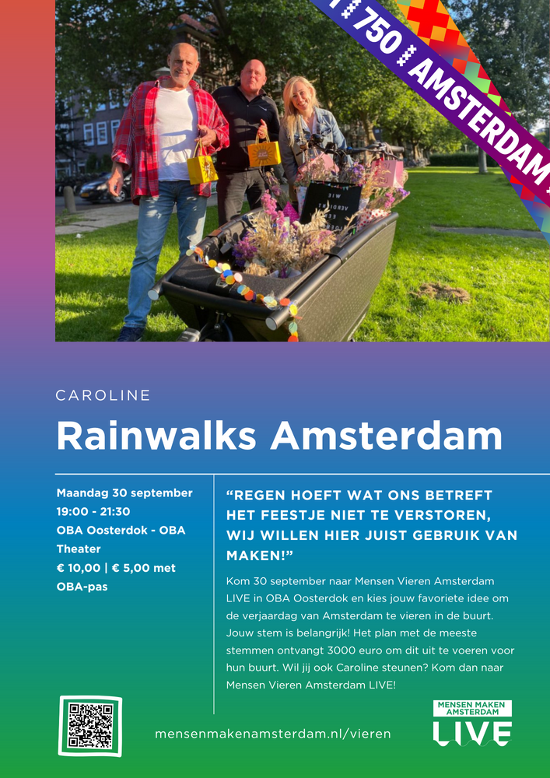


Projects

